Slide 1
Pyelonephritis
Eric Fris, MS4
2/5/2021
RAD 4001

Slide 2
Clinical History
Ms. YD is a 28y.o. female with PMHx of Anemia who presents to the Emergency Room with complaints of back pain, nausea/vomiting, and dizziness.
  Lower back pain began 3 days ago
  Subjective fevers and chills
  BP 119/68 | Pulse 124 | Temp 99.5 °F (37.5 °C) | Resp 18 | Wt 69.9 kg | LMP 01/14/2016 (Approximate) | SpO2 99% | BMI 28.17
  Physical exam: notable for bilateral CVA tenderness, wheezing at lung bases
  Lab workup --->

Slide 3
Clinical History
Urinalysis
Protein, Ur 1+ (*)
Nitrite, Ur Positive (*)
Leukocyte 3+ (*)
Blood, Ur 1+ (*)
RBC 8 (*)
WBC 77 (*)
Mucous Present (*)
WBC Clumps Few (*)
Amorphous Sed Present (*)
103 10
4.5 29 0.7
12.7
39.6
121
16.4 255

Slide 4
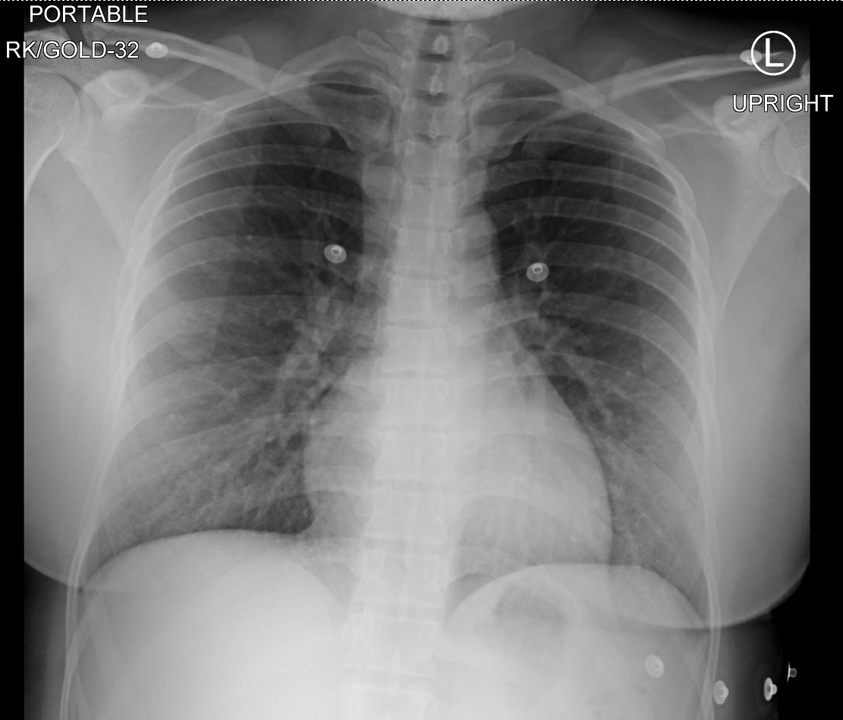
Relevant Imaging
DATE: 1/21/2021 8:59 AM
INDICATION: flank pain, wheezing on right, Wheezing
COMPARISON: CT chest 11/21/2016
TECHNIQUE: AP chest upright
IMPRESSION:
  Subtle bibasilar interstitial thickening and hazy opacities greater in the right lung base suggestive of atypical infection versus interstitial edema or atelectasis.

Slide 5
Clinical History
Problem List
  Pyelonephritis: f/u blood culture, urine culture; continue ceftriaxone 1 g q24, IVF
  Tachycardia: continue to monitor
Interval change:
  01/21/21 1927 95/53 100.1 °F (37.8 °C) P 118 RR 25
  Overnight hospitalist paged, orders CT CAP w/ PE protocol

Slide 6
Relevant Imaging – CT CAP, PE protocol
INDICATION: PE suspected, high pretest prob. Tachycardia
ADDITIONAL INFORMATION: 28-year-old female who was admitted yesterday with pyelonephritis with symptoms of 4 days of back pain and emesis.
TECHNIQUE: Volumetric CT of the chest, abdomen and pelvis acquired following intravenous administration of contrast. Axial, coronal and sagittal images are provided.
  IV contrast: 100 mL of Omnipaque 300
  Enteric contrast: None.
  DLP (mGy-cm): 892.

Slide 7
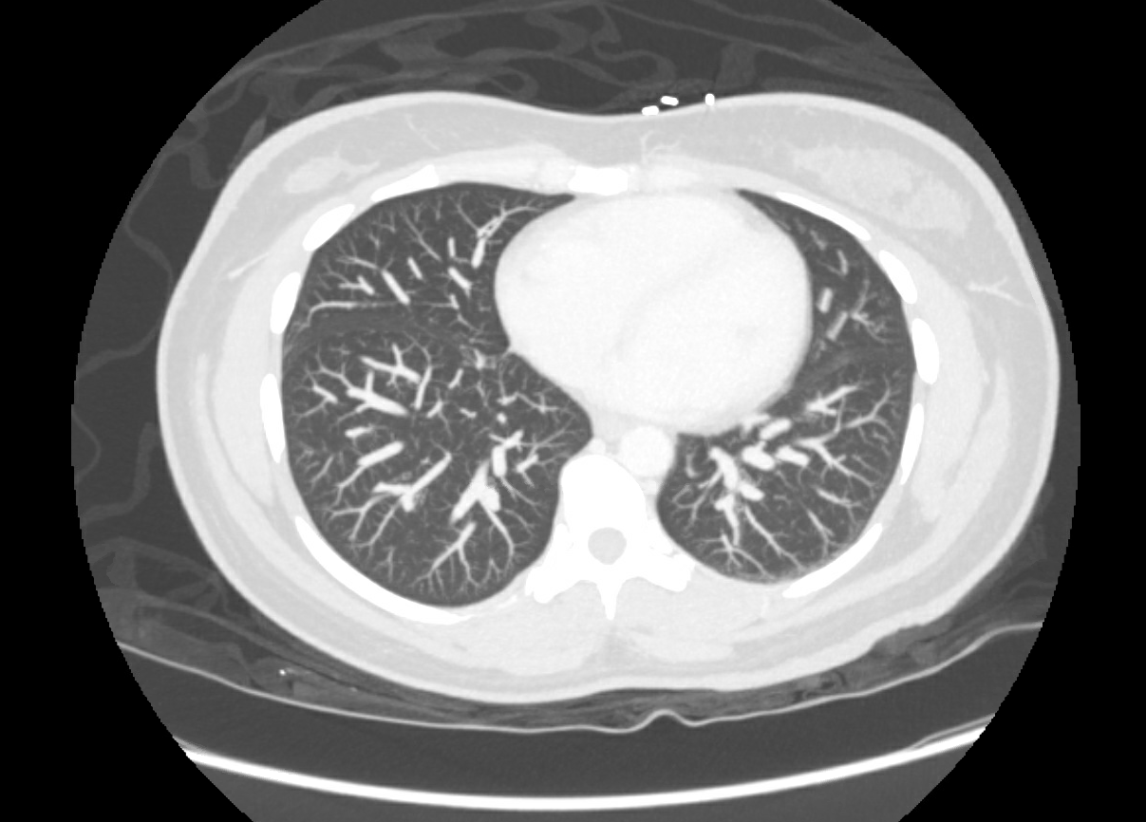
CT PE
Negative for PE

Slide 8
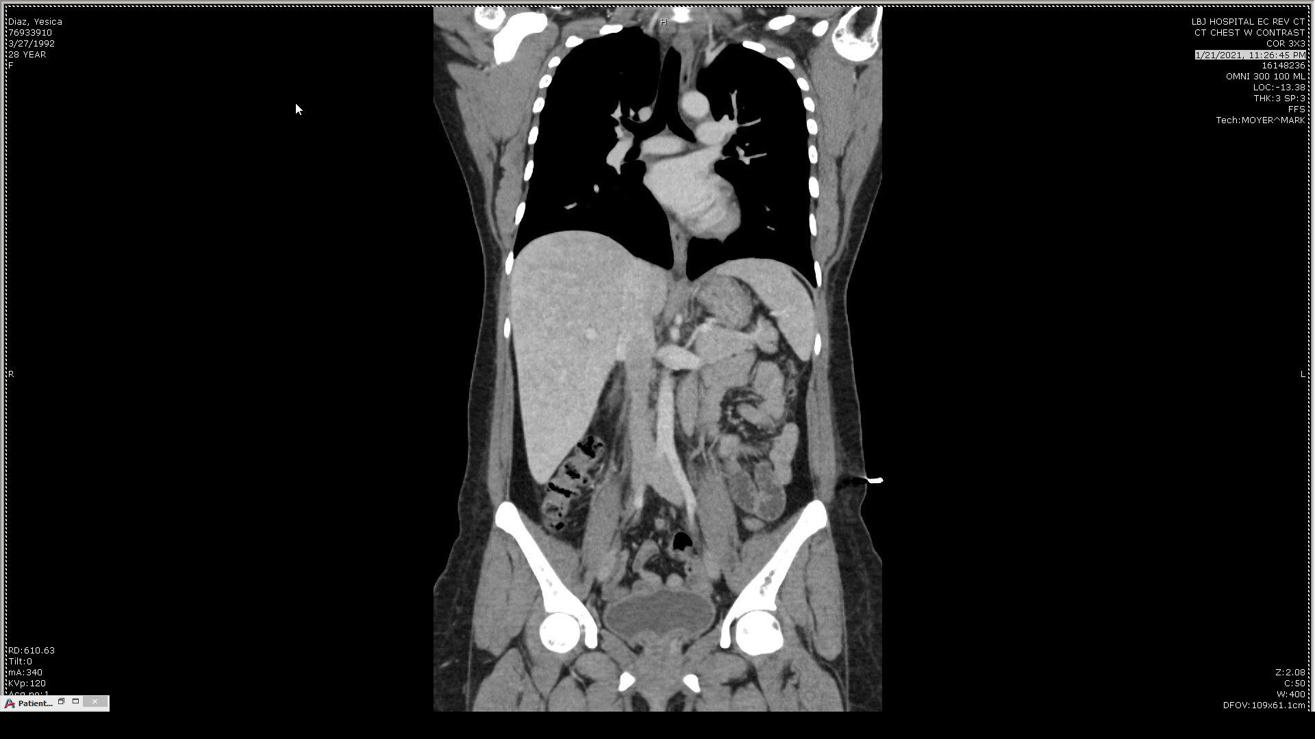
Coronal View

Slide 9
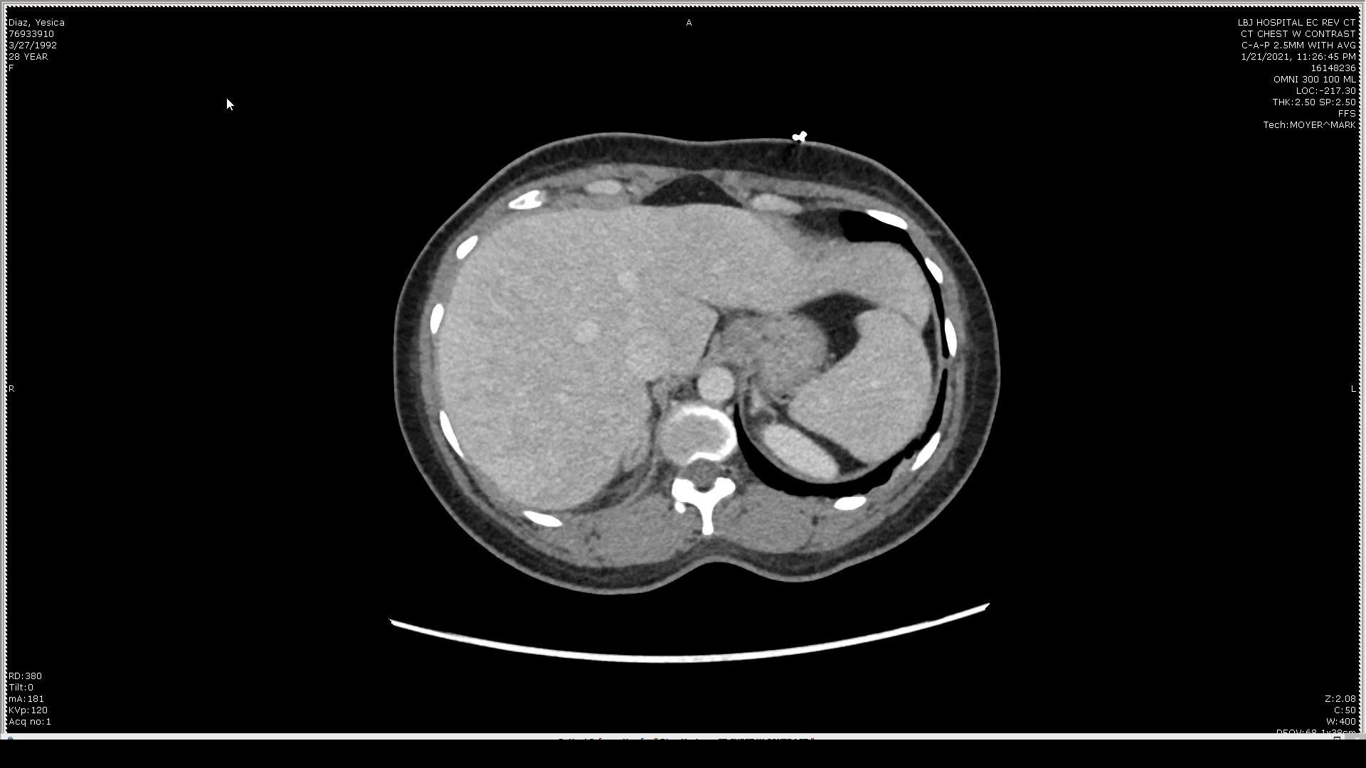
Axial view

Slide 10
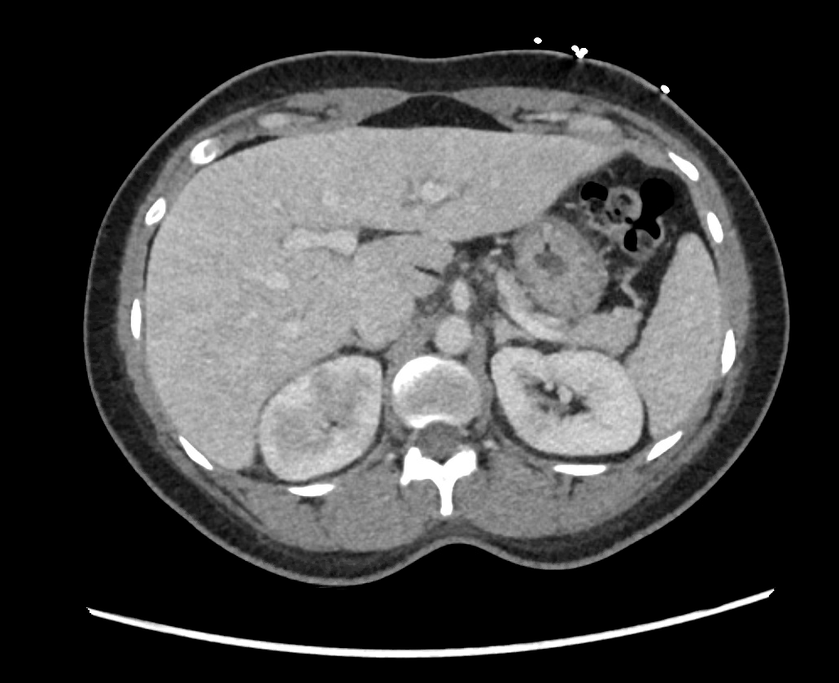
Axial View
Kidneys and ureters:
  Multifocal wedge-shaped hypodensities in the bilateral kidneys, most prominent in the right superior renal pole and the left inferior renal pole. Mild right perinephric and proximal periureteral stranding. No renal calculi or hydronephrosis. No organized fluid collections.

Slide 11
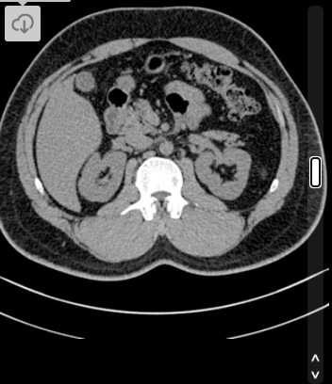
Comparison to normal
Case courtesy of Dr Ian Bickle, Radiopaedia.org, rID: 25889

Slide 12
Differential Diagnosis
Pyelonephritis
UTI
Cystitis
Cervicitis/Prostatitis
  This patient had a TAH 5 years prior

Slide 13
Highlight and summarize key imaging findings
Wedge-shaped hypodensities throughout kidneys in setting of sepsis, +UA, and bilateral CVA tenderness → highly specific for pyelonephritis.
Additionally, overnight team concerned for PE in setting of wheezing, tachycardia, tachypnea, and fever. Negative CT w/ PE protocol has high sensitivity.

Slide 14
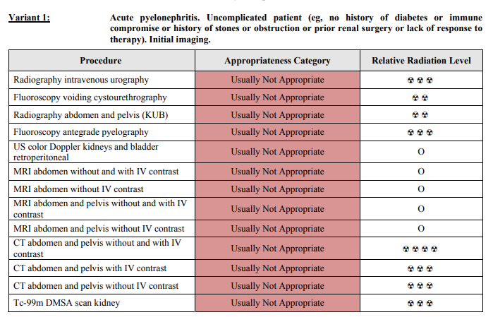
Discussion
Pyelonephritis: presents commonly with dysuria, hematuria, flank pain, +/- systemic signs (fevers, chills, malaise, nausea, vomiting)
This patient had consistent symptoms, UA, and CBC.
No further radiological workup needed.
  In fact, CT abdomen not usually appropriate for uncomplicated pyelonephritis.

Slide 15
Treatment
IV abx (ceftriaxone) --> oral abx (ciprofloxacin)
IV Fluids (LR)
No follow up imaging required

Slide 16
Final Diagnosis
Pyelonephritis
Sepsis

Slide 17
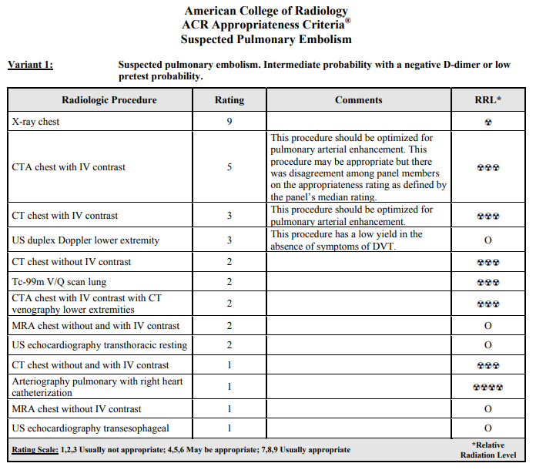
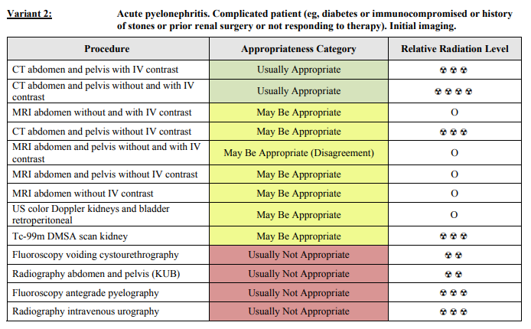
ACR appropriateness Criteria
Appropriate use of CT for PE protocol.
Extending the CT to abdomen/pelvis?
  Patient interval change (unstable vitals, persistence of fever after initiation of ceftriaxone and acetaminophen).
  Night team decision
  Complicated includes “not responding to therapy” (does patient’s worsening status count as non-response?)
Cost:
  CT Chest contrast (CPT 71260) = $519.24
  CT Abd/Pelvis w/wo (CPT 74178) = $1088.12
  CXR (CPT 71045) = $227.43
    https://www.stelizabeth.com/patients-visitors/patient-pricing

Slide 18
Take Home Points / Teaching points
Pyelonephritis typically presents with flank pain, dysuria, +UA, high WBC
Imaging not needed, but may be important if high suspicion of other diagnoses in the differential
Look for wedge shaped hypodensities in the renal architecture on CT abdomen
Renal calculi, hydronephrosis, or other fluid collections point to other renal disease

Slide 19
References
Radiopaedia.org, rID: 25889
https://www.stelizabeth.com/patients-visitors/patient-pricing
https://www.acr.org/Clinical-Resources/ACR-Appropriateness-Criteria
Patient data: LBJ Harris Health Epic system

Slide 20

Questions?

