Slide 1
VACTERL
Tori Waters
02/05/2021
Radiology 4001
Jennifer McCarty, MD

Slide 2
Clinical History
Patient: Newborn female born at 36 weeks to a G3P2→3 female via repeat c-section.
  Pregnancy complicated by PROM at 36 weeks. At OSH, after routine resuscitation, imperforate anus and perianal skin tag identified on initial exam.
  Mother GBS + with inadequate treatment: Sepsis ruled out. Mother COVID +’ve, patient –’ve.
  Patient transferred to MHH-TMC for surgical intervention (posterior sagittal anorectoplasty) and further workup.

Slide 3
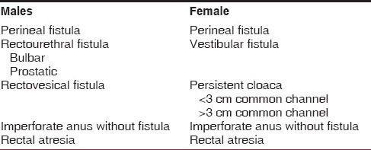
Imperforate Anus Differential Diagnosis and Associated Abnormalities
  Pena classification for Anorectal malformations (1)
  Operative Report states patient had vestibular fistula
    Most common defect in females
    Good prognosis
  Associated abnormalities –
    Sacral deformities
    Genitourinary defects
    VACTERL
    Genetic syndromes

Slide 4
VACTERL Review
Must have 3 of the following for VACTERL
V → Vertebral anomalies
A → Anal Atresia/Imperforate Anus
C → Cardiovascular anomalies
T → Tracheoesophageal fistula
E → Esophageal Atresia
R → Renal Anomalies
L → Limb defects

Slide 5
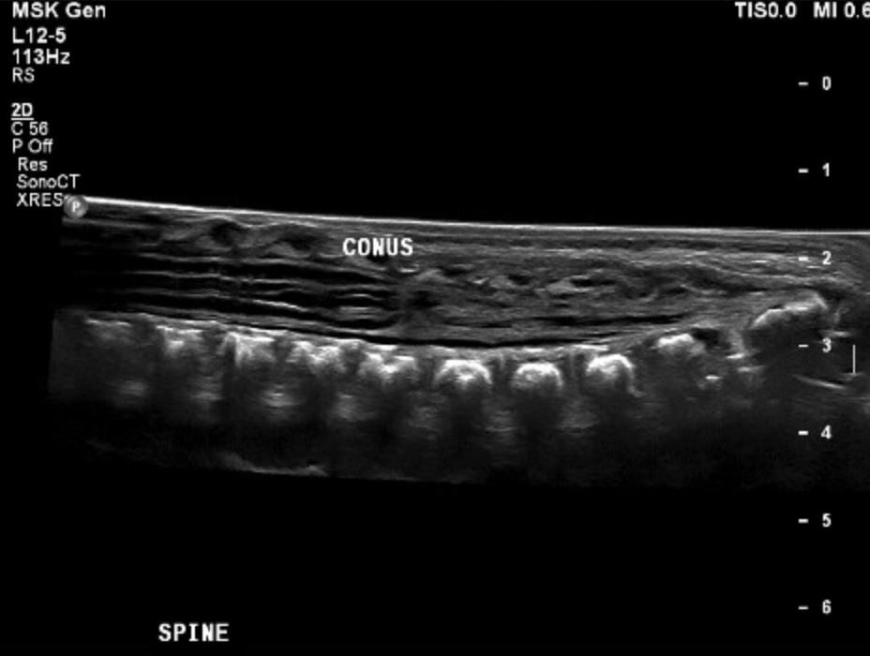
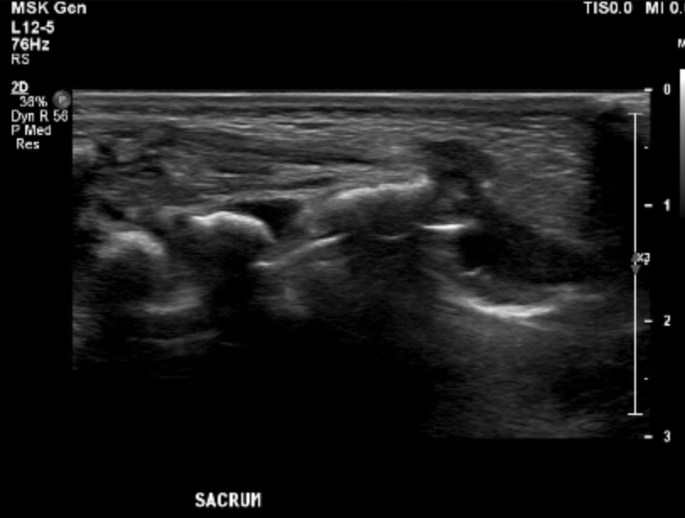
VACTERL Workup - V
Spinal Ultrasound 09/04/2020 2:57 PM
  Indication: Imperforate anus, VACTERL work-up
  Findings: Multiple sacral vertebral anomalies. Conus terminates at approximately L3-L4.

Slide 6
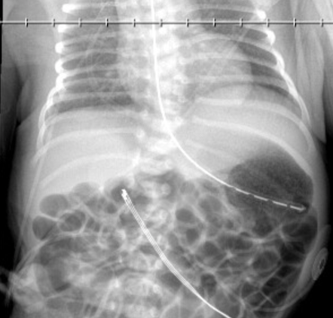
VACTERL Workup - V Continued
Chest/Abd Pediogram 1 view DX 09/04/2020 12:25 PM
Abnormal Findings: “Sacral spine segmentation anomalies and likely segmentation anomalies at T7-T8”
Per Discharge note, no acute surgical intervention needed but “will require MRI entire spine under general anesthesia at 3 months CGA”

Slide 7
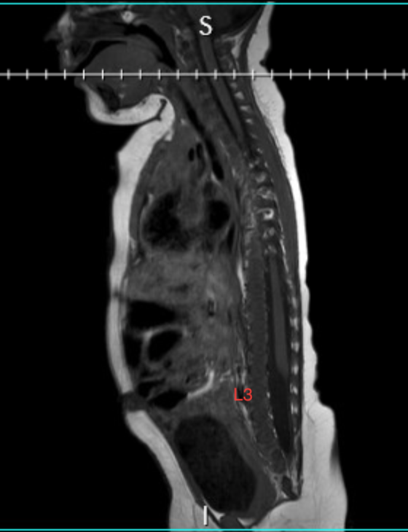
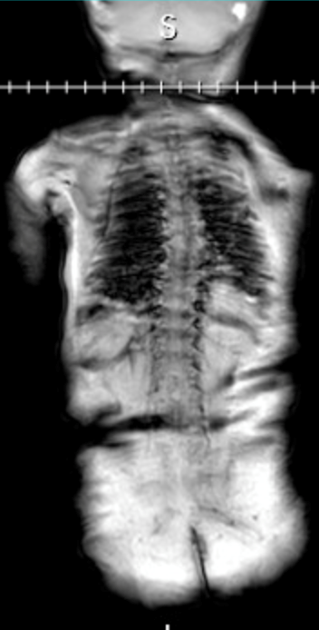
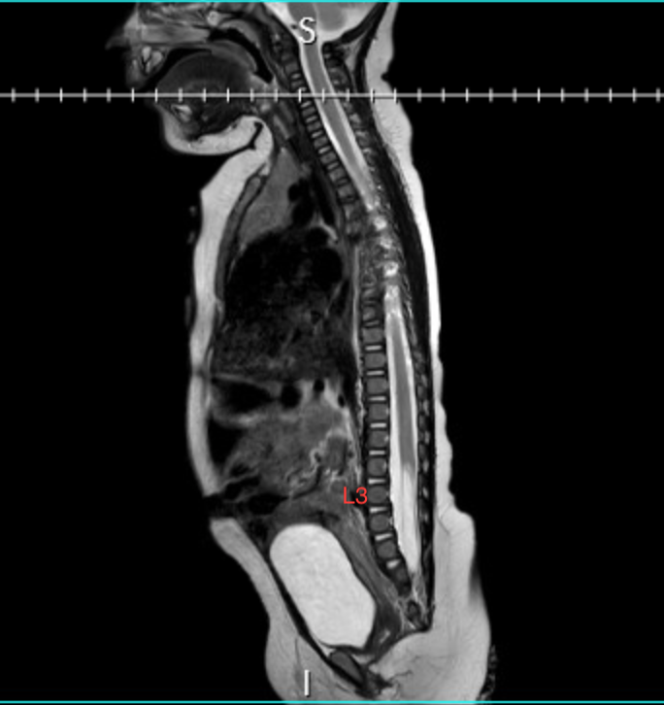
VACTERL – V Continued
Left to Right: Sagittal T1, Coronal, Sagittal T2j
Spine Entire wo Contrast MRI 1/28/2021 14:22
Notes:
Abnormal Findings:
Thoracic Spine: mild leftward curvature. Vertebral segmentation anomalies (better seen on radiograph) – split vertebral body at T8, a hemivertebra between T7 and T8 on left.
Lumbar Spine: Flattened conus medullaris at T3. Tethered cord with fatty filum terminale.
Sacrum: Partial sacral agenesis (thought to represent caudal regression syndrome)

Slide 8
VACTERL Workup
V – See previous slides
A – Imperforate anus
C – Found to have PDA on ECHO
T – No Tracheoesophageal fistula noted in chart
E – No esophageal atresia
R – Small for gestational age kidneys noted with no other abnormalities. Normal for height and weight.
L – No limb abnormalities noted in chart

Slide 9
Summary of Key Findings
3 of VACTERL findings present
  V – Caudal regression/sacral abnormalities, flattened conus medullaris at level of T3, tethered cord with fatty filum terminale, abnormalities of T7 – T8 vertebrae.
  A – Imperforate anus with vestibular fistula (s/p posterior sagittal anorectoplasty)
  C – PDA (follow up with outpatient cardiology)
  TERL – No known abnormalities with plan to continue to follow with renal.

Slide 10
Differential Diagnosis
VACTERL
VACTERL – H (no hydrocephalus noted on MRI brain) (2)
CHARGE syndrome – (no genetic testing in chart, no colobomata noted on physical exam, no abnormal facial features noted) (2)
Fanconi Anemia – No radial anomalies noted, no thrombocytopenia (2)

Slide 11
Discussion
VACTERL:
  Pathophysiology: abnormalities in structures derived from embryonic mesoderm. Many proposed mechanisms (mitochondrial dysfunction, heterozygous mutations in HOXD13) and known risk factors (maternal diabetes, in utero exposure to estrogen +/- progesterone, statins) (2)
  Epidemiology: 1/10,000 – 1/40,000 infants. (2)
Further work up or management done/needed – As particular emphasis is put on radial anomalies to initiate workup for Fanconi Anemia, might consider radiographs. Continue following cardiac malformations, renal function (with U/S), and GI. Consider evaluation by neurosurgery for tethered cord. Genetic testing ??

Slide 12
Final Diagnosis
VACTERL
  With vertebral abnormalities, cardiac, and imperforate anus.

Slide 13
ACR appropriateness Criteria
No specific ACR criteria for VACTERL
Estimated costs of imaging:
  MRI Spine: $3,600
  Chest Xray, 1 view: $380
  Spine Ultrasound: $500-700
  Nationwidechildrens.org/your-visit/billing-and-insurance/pay-my-bill/price-information-list

Slide 14
Take Home Points / Teaching points
Finding of imperforate anus on initial newborn exam requires extensive workup.
VACTERL is diagnosis of exclusion, must rule out overarching diagnoses (i.e. Fanconi anemia). Consider genetic testing. (2)
Beware abnormal presentations (i.e. low conus medullaris with caudal regression)

Slide 15
References
Singh M, Mehra K. Imperforate Anus. [Updated 2020 Jul 10]. In: StatPearls [Internet]. Treasure Island (FL): StatPearls Publishing; 2020 Jan-. Available from: https://www.ncbi.nlm.nih.gov/books/NBK549784/
Solomon BD. VACTERL/VATER Association. Orphanet J Rare Dis. 2011;6:56. Published 2011 Aug 16. doi:10.1186/1750-1172-6-56
Weerakkody, Y., & Baba, Y. (2020). Caudal regression syndrome | Radiology Reference Article | Radiopaedia.org. Https://Radiopaedia.Org/Articles/Caudal-Regression-Syndrome?Lang=us. https://radiopaedia.org/articles/caudal-regression-syndrome?lang=us

Slide 16

Questions?

